Slide 1
Scale GNN to giant graph in DGL
Da Zheng

Slide 2
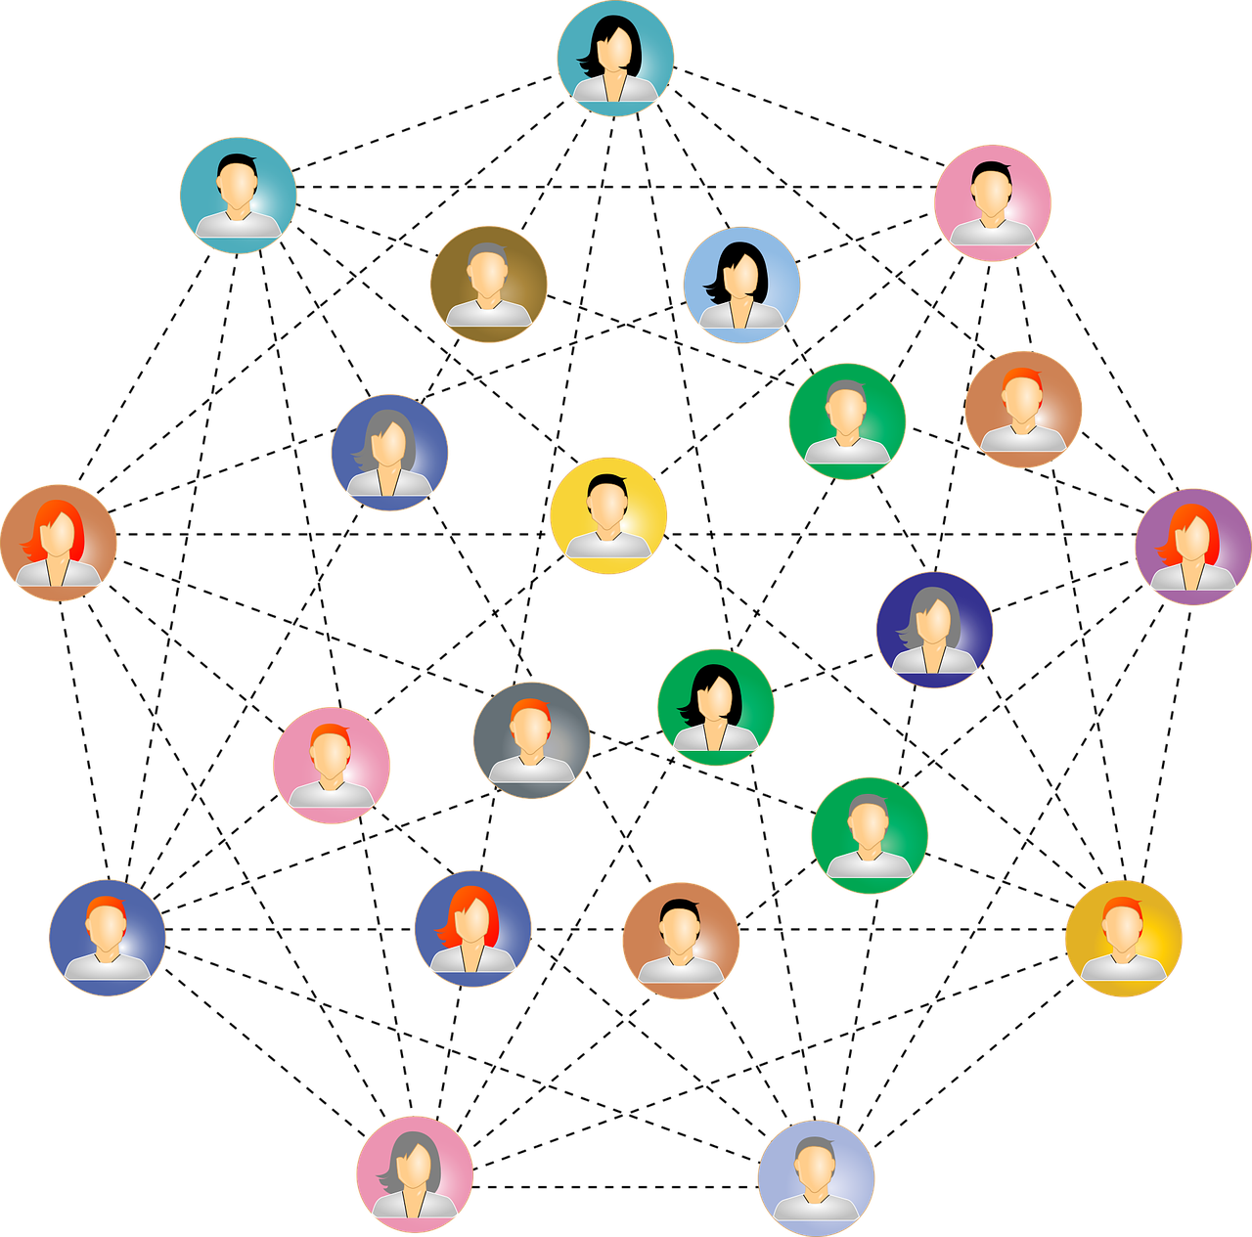
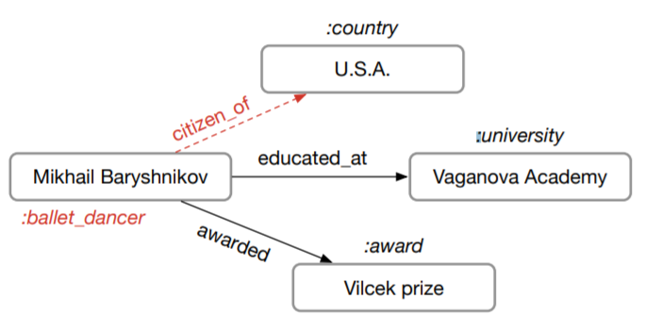
Train GNN on giant graphs
users
products
Social network
Knowledge graph
Recommendation
|V|: 100M – 1B
|V|: 1M – 100M
|V|: 1M – 1000M

Slide 3
Full graph training
Run forward and backward computation on the full graph.
Memory consumption of a GNN model is proportional to |V| and |E|.
A graph with 1B edges may require terabytes of memory to store data.

Slide 4
Recap: mini-batch training in deep learning

Slide 5
Recap: mini-batch training in deep learning
DL models
Batch 1
Data points are independent and identically distributed (IID).
The full dataset

Slide 6
How to apply mini-batch training to graphs?
Nodes (data points) in graphs have edges (dependencies).
2
3
1
2
3
10
5
9
4
1
6
8
7
4
11

Slide 7
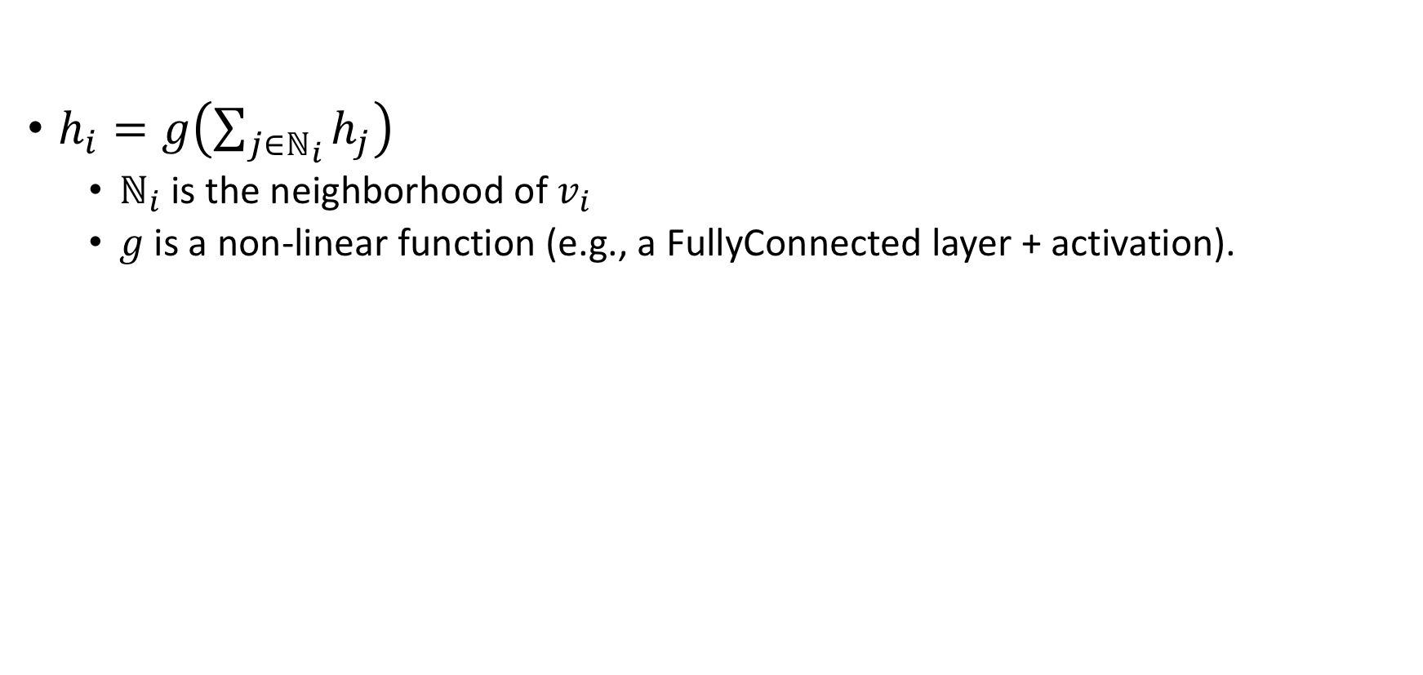
Recap: Graph convolution network (GCN)
$h_{i}=g\left(\sum_{j∈ℕ_{i}}{h_{j}}\right)$
$ℕ_{i}$ is the neighborhood of $v_{i}$
$g$ is a non-linear function (e.g., a FullyConnected layer + activation).
Notes:
We need to describe the concept of layers.

Slide 8
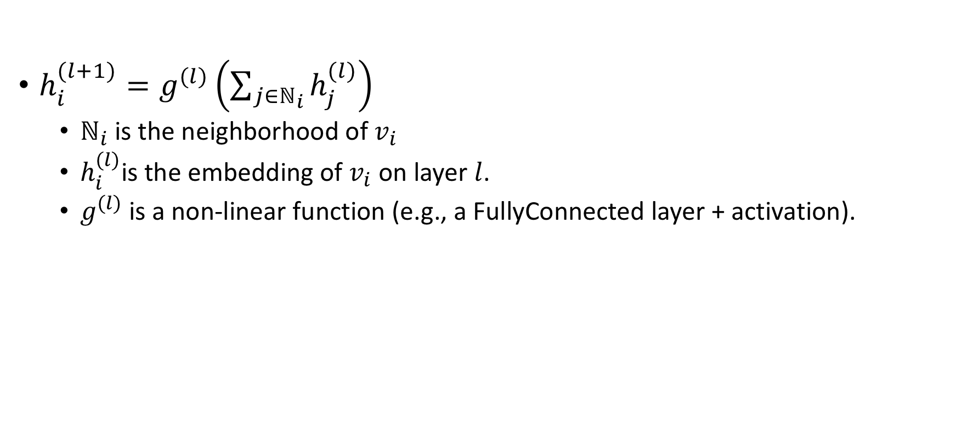
Multi-layer GCN
$h_{i}^{(l+1)}=g^{(l)}\left(\sum_{j∈ℕ_{i}}{h_{j}^{(l)}}\right)$
$ℕ_{i}$ is the neighborhood of $v_{i}$
$h_{i}^{(l)}$is the embedding of $v_{i}$ on layer $l$.
$g^{(l)}$ is a non-linear function (e.g., a FullyConnected layer + activation).

Slide 9
Why multi-layer GCN?

Slide 10
Two-layer GNN from the perspective of a vertex
Compute the embedding of node 1 of layer 2
2
3
1
10
5
9
4
6
8
7
11

Slide 11

Two-layer GNN from the perspective of a vertex
Compute the embedding of node 1 of layer 2:
$h_{1}^{(2)}=g^{(2)}\left(h_{2}^{\left(1\right)}+h_{3}^{\left(1\right)}+h_{4}^{\left(1\right)}+h_{5}^{\left(1\right)}+h_{6}^{\left(1\right)}\right)$
2
3
1
10
5
9
4
6
8
7
11

Slide 12

Two-layer GNN from the perspective of a vertex
Compute the embedding of node 1 of layer 2:
$h_{1}^{(2)}=g^{(2)}\left(h_{2}^{\left(1\right)}+h_{3}^{\left(1\right)}+h_{4}^{\left(1\right)}+h_{5}^{\left(1\right)}+h_{6}^{\left(1\right)}\right)$
Compute the embedding of nodes $i$ of layer 1:
$h_{2}^{(1)}=g^{(1)}\left(h_{1}^{\left(0\right)}\right)$
2
3
1
10
5
9
4
6
8
7
11
Notes:
Say $h_{6}^{(0)}$ is the input data.

Slide 13

Two-layer GNN from the perspective of a vertex
Compute the embedding of node 1 of layer 2:
$h_{1}^{(2)}=g^{(2)}\left(h_{2}^{\left(1\right)}+h_{3}^{\left(1\right)}+h_{4}^{\left(1\right)}+h_{5}^{\left(1\right)}+h_{6}^{\left(1\right)}\right)$
Compute the embedding of nodes $i$ of layer 1:
$h_{3}^{(1)}=g^{(1)}\left(h_{1}^{\left(0\right)}+h_{4}^{\left(0\right)}\right)$
2
3
1
10
5
9
4
6
8
7
11
Notes:
Say $h_{6}^{(0)}$ is the input data.

Slide 14
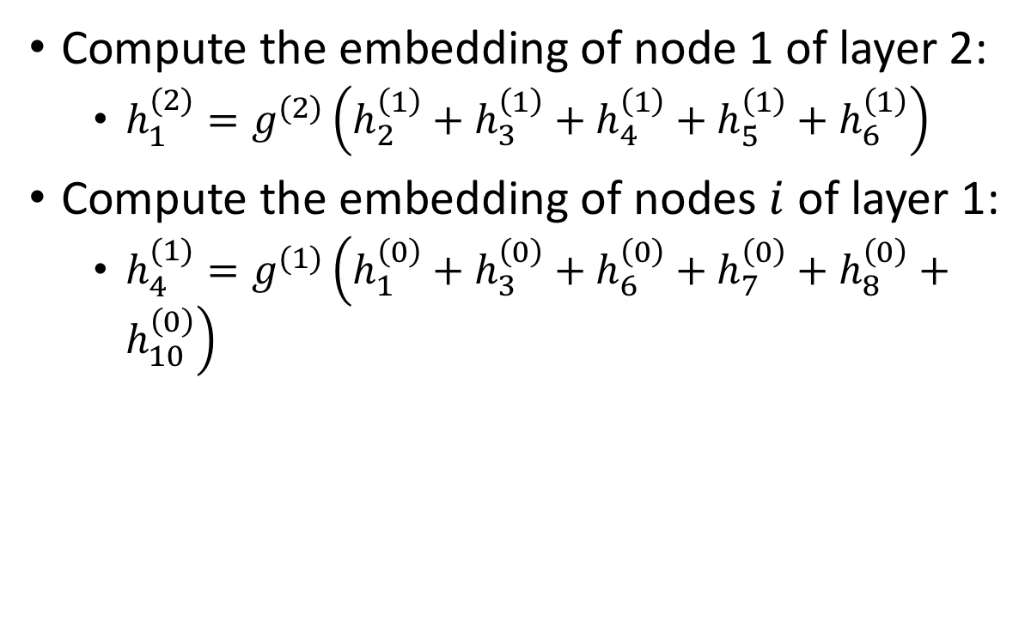
Two-layer GNN from the perspective of a vertex
Compute the embedding of node 1 of layer 2:
$h_{1}^{(2)}=g^{(2)}\left(h_{2}^{\left(1\right)}+h_{3}^{\left(1\right)}+h_{4}^{\left(1\right)}+h_{5}^{\left(1\right)}+h_{6}^{\left(1\right)}\right)$
Compute the embedding of nodes $i$ of layer 1:
$h_{4}^{(1)}=g^{(1)}\left(h_{1}^{\left(0\right)}+h_{3}^{\left(0\right)}+h_{6}^{\left(0\right)}+h_{7}^{\left(0\right)}+h_{8}^{\left(0\right)}+h_{10}^{\left(0\right)}\right)$
2
3
1
10
5
9
4
6
8
7
11
Notes:
Say $h_{6}^{(0)}$ is the input data.

Slide 15
Two-layer GNN from the perspective of a vertex
Compute the embedding of node 1 of layer 2:
$h_{1}^{(2)}=g^{(2)}\left(h_{2}^{\left(1\right)}+h_{3}^{\left(1\right)}+h_{4}^{\left(1\right)}+h_{5}^{\left(1\right)}+h_{6}^{\left(1\right)}\right)$
Compute the embedding of nodes $i$ of layer 1:
$h_{3}^{(1)}=g^{(1)}\left(h_{1}^{\left(0\right)}+h_{4}^{\left(0\right)}\right)$
2
3
1
10
5
9
4
6
8
7
11
Notes:
Say $h_{6}^{(0)}$ is the input data.

Slide 16

Two-layer GNN from the perspective of a vertex
Compute the embedding of node 1 of layer 2:
$h_{1}^{(2)}=g^{(2)}\left(h_{2}^{\left(1\right)}+h_{3}^{\left(1\right)}+h_{4}^{\left(1\right)}+h_{5}^{\left(1\right)}+h_{6}^{\left(1\right)}\right)$
Compute the embedding of nodes $i$ of layer 1:
$h_{6}^{(1)}=g^{(1)}\left(h_{1}^{\left(0\right)}+h_{4}^{\left(0\right)}+h_{7}^{\left(0\right)}+h_{11}^{\left(0\right)}\right)$
2
3
1
10
5
9
4
6
8
7
11
Notes:
Say $h_{6}^{(0)}$ is the input data.

Slide 17


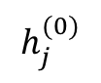
A view of data dependency
Neighborhood size increases exponentially when L increases.
$$h_{1}^{(2)}$$
1
$$h_{i}^{(1)}$$
2
3
4
5
6
$$h_{j}^{(0)}$$
1
3
4
6
7
8
9
10
11

Slide 18
mini-batch training on graphs
Step 1: randomly sample target nodes.
Sample nodes for computing node embeddings.
Step 2: randomly sample neighbors
Equivalent to prune the computation for node embeddings.

Slide 19
Sampling strategies
Neighbor sampling
Control-variate based sampling
Layer-wise sampling
Random walk sampling

Slide 20
Sampling strategies
Neighbor sampling
Control-variate based sampling
Layer-wise sampling
Random walk sampling

Slide 21
Neighbor sampling
Always sample neighbors from a neighbor list of a vertex.

Slide 22
Neighbor sampling
Always sample neighbors from a neighbor list of a vertex.
1
1
2
3
4
5
6
2
4
1
7
8
1
3
4
6
7
8
9
10
11

Slide 23
Control variate based sampling
Use history data to estimate node embedding with fewer sampled neighbors.

Slide 24
Control variate based sampling
Use history data to estimate node embedding with fewer sampled neighbors.
1
1
2
3
4
5
6
2
5
6
4
3
1
7
8
10
1
3
4
6
7
8
9
10
11

Slide 25
Mini-batch training in GNN models
2
3
1
1
GNN models
10
5
2
4
9
4
6
8
7
1
7
8
11
A batch
The full graph

Slide 26
NodeFlow
DGL defines NodeFlow to capture the sampling results.
1
1
1
2
3
4
5
6
2
4
6
4
1
3
4
6
7
8
9
10
11
1
7
8
11
7
8

Slide 27
NodeFlow
The DGL API defined for training GNN models with the sampling methods.
Nodes are grouped into layers.
To access node data:
nf.layers[0].data[‘h’]
To perform computation on nodes:
nf.apply_layers(0)
1
Layer 2
2
4
Layer 1
1
7
8
Layer 0

Slide 28
NodeFlow
The DGL API defined for training GNN models with the sampling methods.
Nodes are grouped into layers.
Edges are grouped into blocks.
To access edge data:
nf.blocks[0].data[‘h’]
To perform computation on edges:
nf.block_compute(0)
1
Block 1
2
4
Block 0
1
7
8

Slide 30
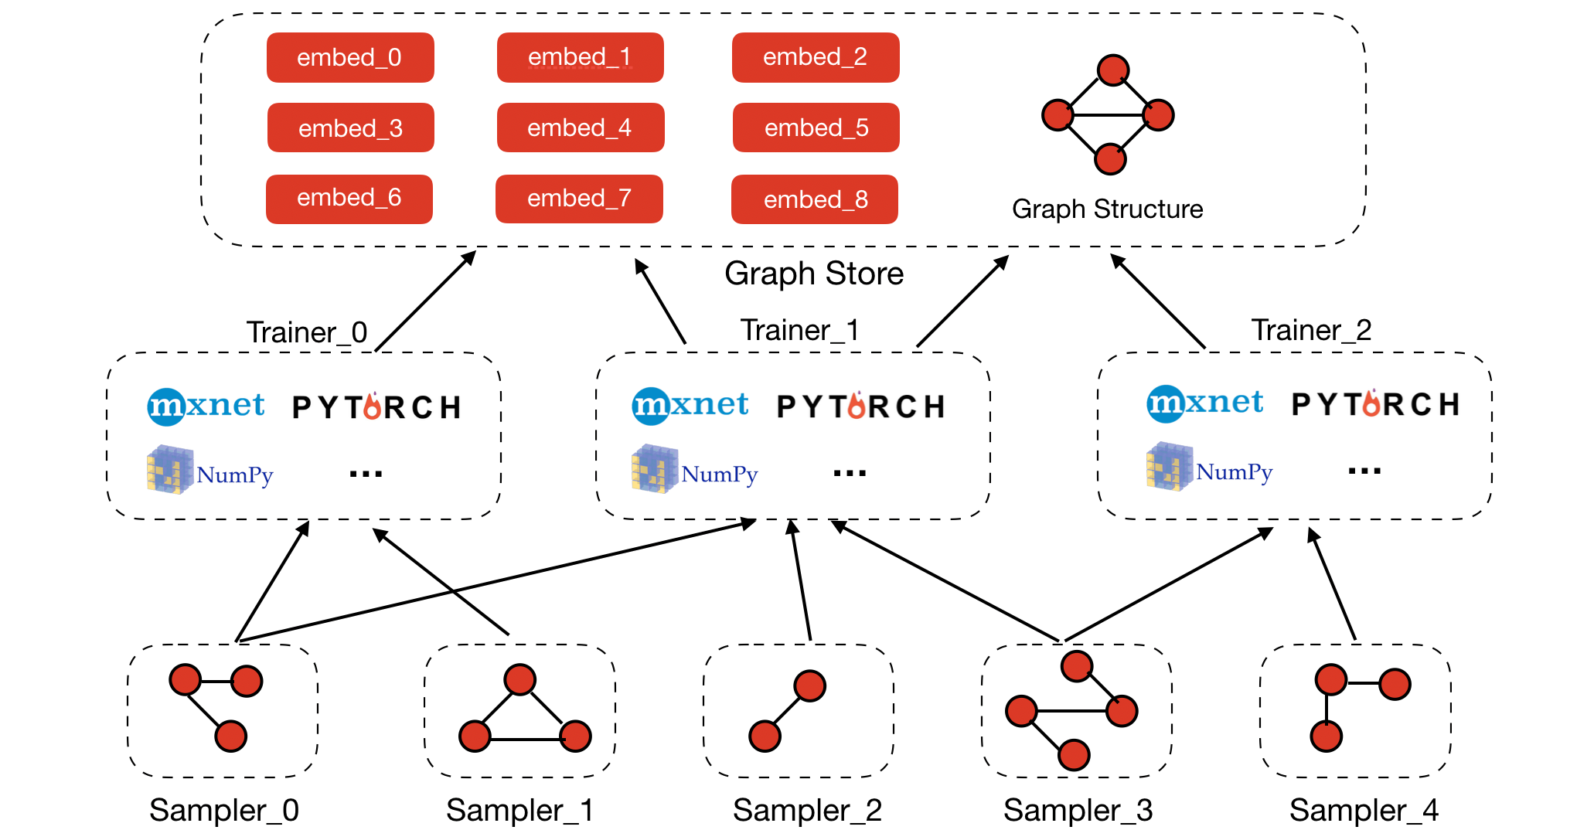
DGL architecture for scaling

Slide 31
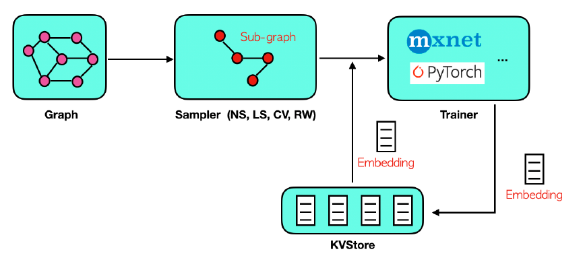
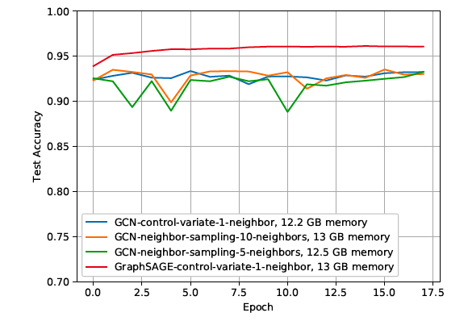
Is DGL scalable?
Support different sampling algorithms
Neighbor sampling
Layer-wise sampling
Control-variate sampling
Random walk sampling

Slide 32
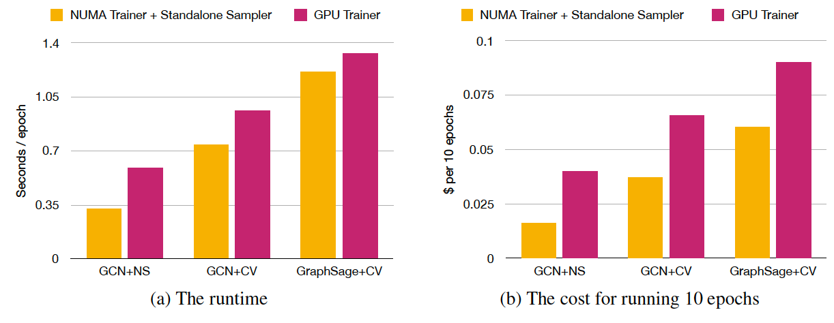
Is DGL scalable?
Supported hardware for scaling: multiple GPUs and multi-processor machines.
Multi-processor machines are more efficient and cost-effective for simple graph neural networks.

Slide 33
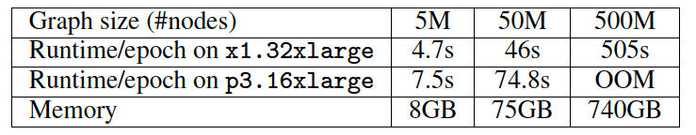
Is DGL scalable?
Scaling to graphs with 500M nodes on a machine with 2TB RAM.
The full distributed solution is under development.

